Slide 1
Customer Segmentation

Slide 2
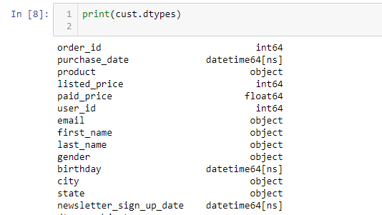
Given Column Data Types

Slide 3

Column Shape
The shape of the given column is as shown:
The dataframe has 2000 rows and 19 columns.

Slide 4
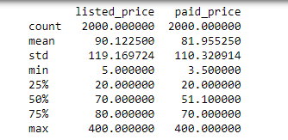
Listed price and Paid Price Description

Slide 5
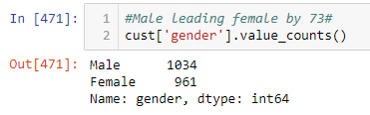
Male and Female Counts

Slide 6
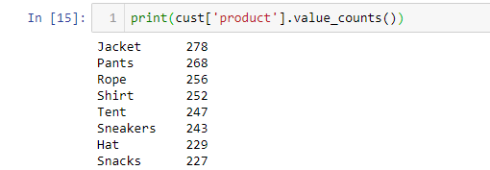
Product type and their counts

Slide 7

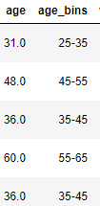
Extraction of age and creation of age bins from the given birthday

Slide 8
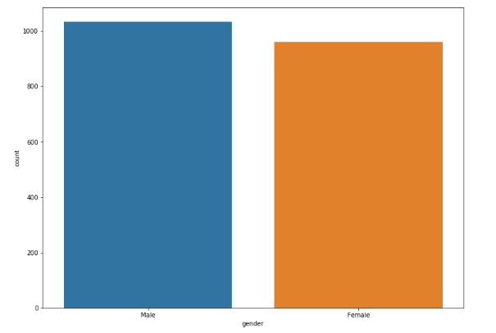
Male Vs Female count

Slide 9
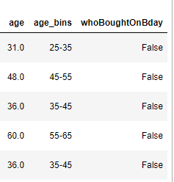
Boolean column for getting the info of which customer bought products on their birthday

Slide 10

From purchase_date extracting the month & year of purchase for further analysis

Slide 11
Customer Segmentation
Customer Segmentation can be done by clustering. So tried K-Means Clustering.
But the given data contains categorical variables(which should not be given to K-Means clustering).Hence used the technique of Principle Component Analysis(PCA).
For PCA, categorical variables have to be converted to 1’s and 0’s by the use of LABLE encoding and ONE HOT encoding Technique.

Slide 12
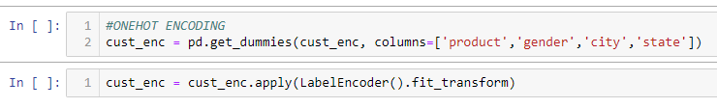
After PCA technique
After doing PCA on the dateframe, we find that the maximum variances that PC can cover is 24.95 which implies that around 75% of the variance are not captured by PCA.

Slide 13
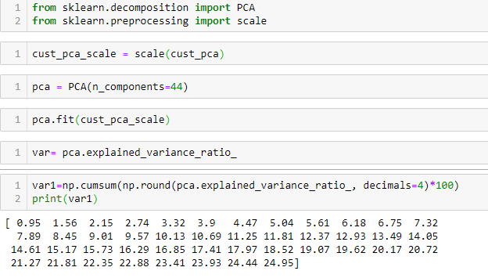

Slide 14
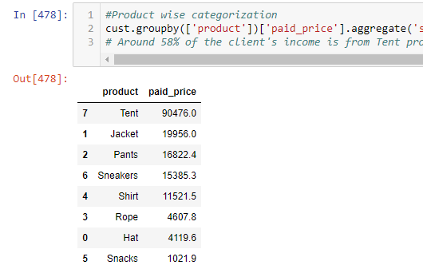
Categorization by Products - List of users who contribute 58% of the total sales
Product type (tents)

Slide 15
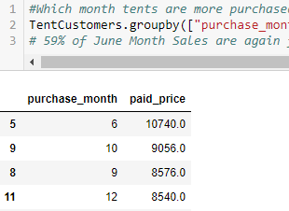
Further drilling down on the customers who bough tents, it was inferred that 59% of sales were on the summer month of June
Some of the states where Tens are bought more – ‘Texas','Florida','California','District of Columbia','Pennsylvania'

Slide 16
We can conclude that less customers spent more on Tents and if we send recommendation via email/ Facebook, then most of the ads will be converted into sales during the summer

Slide 17
Sending recommendations during the customer’s birthdays
Just 184 customers spent money(10% of total sales) for their birthdays
If we concentrate on the remaining chunk of customers and if we send them offers/ discounts, then there will be more birthday sales.

Slide 18
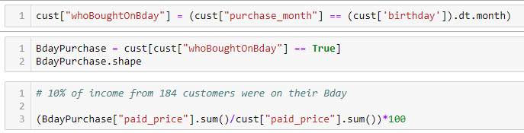

Slide 19
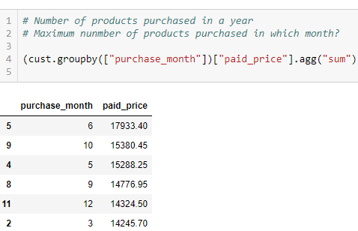
Grouping customers by their purchase patterns based on the purchase month

Slide 20
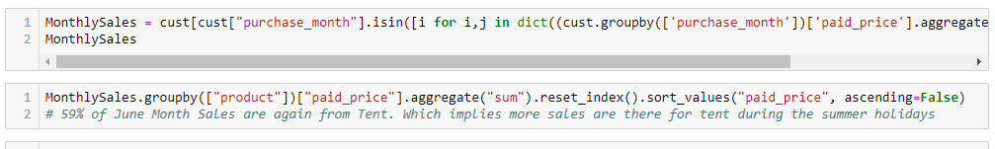
We can see that most sales are either in the Summer months or during the holiday season(thanksgiving & Christmas)

Slide 21
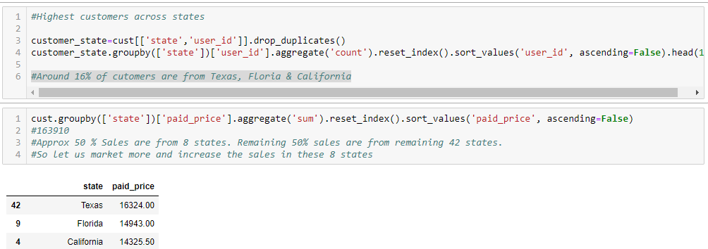
Around 16% of customers are from Texas, Florida & California
So, sending recommendations to the list of users from these states will increase the sales of the products

Slide 22
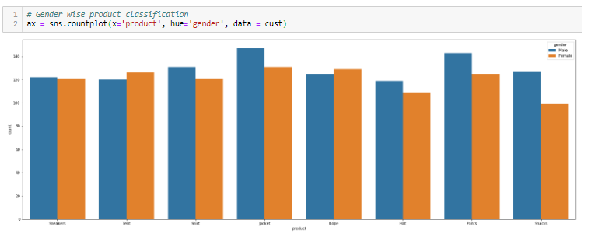
Gender wise product Classification

Slide 23
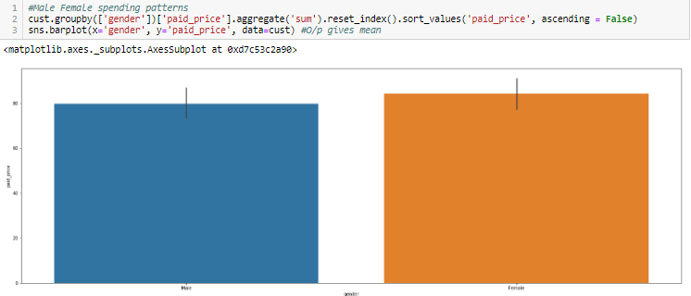
Male Female spending pattern

Slide 24
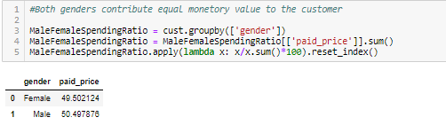
Both genders contribute equal monitory value to the customers

Slide 25
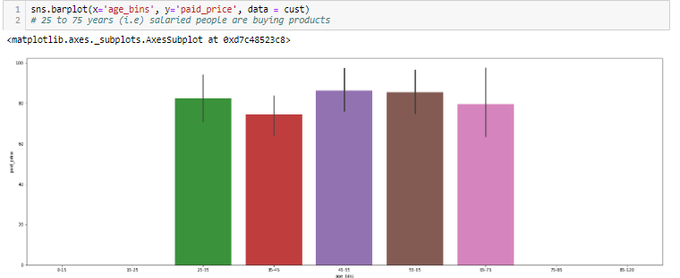
It could be inferred that salaried people are buying products from the client

Slide 26
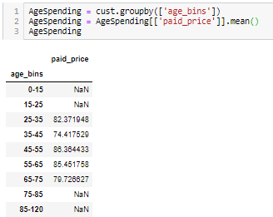
Average spending - Age wise categorization

Slide 27
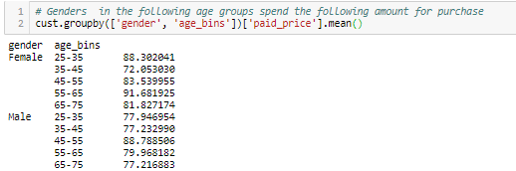
Further drilling down based on genders

Slide 28
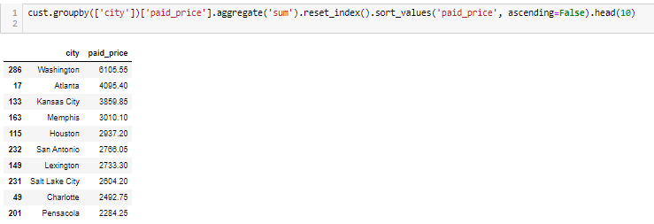
Top 10 cities that contribute to the sales of the products

Slide 29
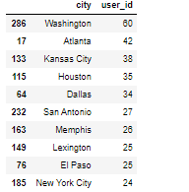
Top 10 city customer base across USA

Slide 30
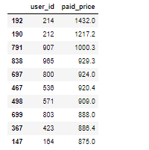
Users who have contributed more monitory value to the client

